Slide 1










RETAIL ANALYSIS USING SQL
Presented By: Dristi Handique
Date: 09-08-2025

Slide 2

INTRODUCTION
The project focuses on a retail company facing challenges with sales transaction, customer profile and inventory management. Through a comprehensive data analysis approach using SQL, this case study aims to address key business problems and insights such as high and low sales products, segment the customer base, and analyze customer behavior.

Slide 3
DATABASE STRUCTURE
Sales_transaction
TransactionID
CustomerID
Customer_profiles
CustomerID
Product_inventory
ProductID
ProductID
QuantityPurchased
TransactionDate
Price
Age
Gender
Location
JoinDate
ProductName
Category
StockLevel
Price

Slide 4
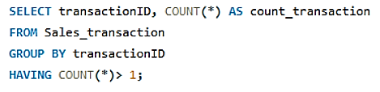
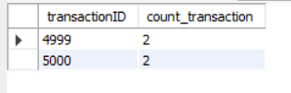
QUERY 1: Clean the sales_transaction table by identifying and removing duplicate entries.

Slide 5
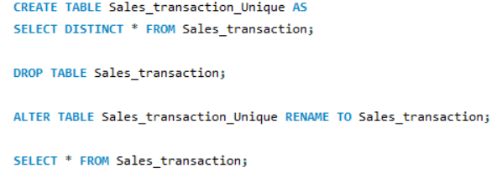
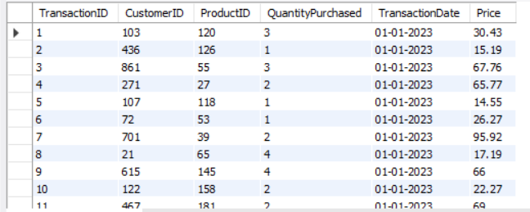
QUERY 2: Clean the sales_transaction table by identifying and removing duplicate entries.

Slide 6
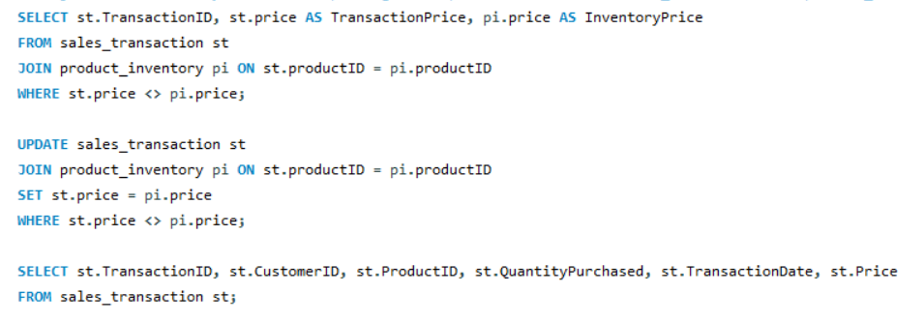
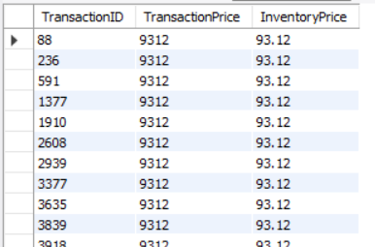
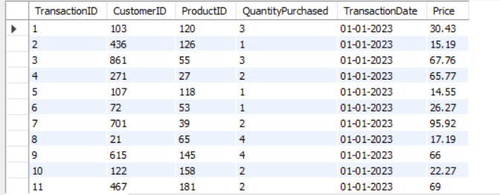
QUERY 3: Identify and resolve pricing discrepancies between the sales_transaction and product_inventory tables by aligning the transaction prices with the correct inventory prices for the same products.

Slide 7
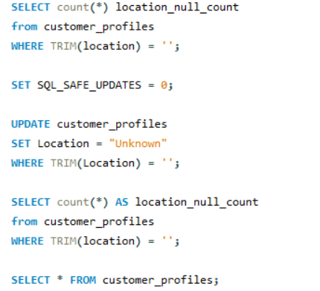
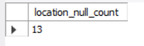
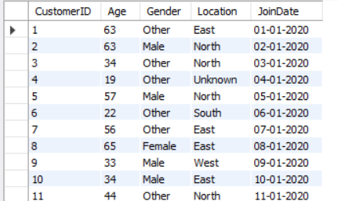
QUERY 4: Clean the sales_transaction table by identifying and removing duplicate entries.

Slide 8
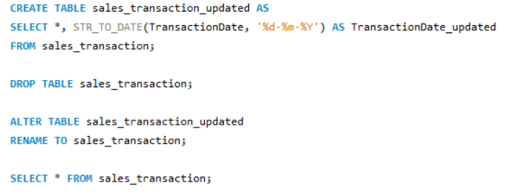
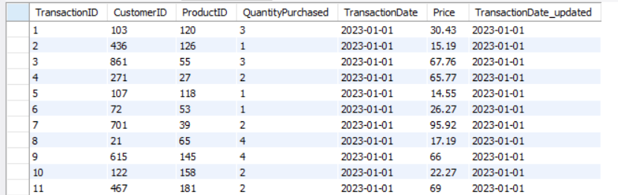
QUERY 5: Clean and correct the data type of the DATE column from TEXT to a standard DATE format.

Slide 9
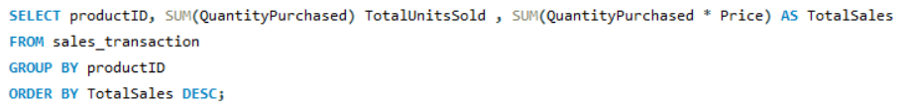
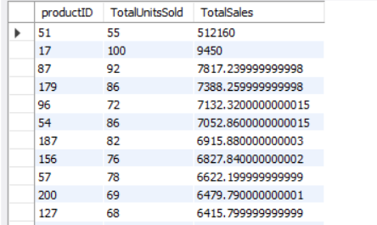
QUERY 6: Summarize the total sales and quantities sold per product by the company.

Slide 10
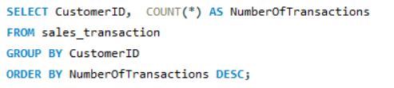
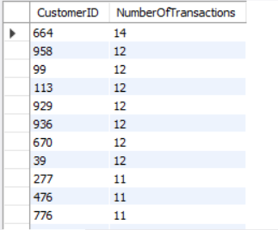
QUERY 7: Count the number of transactions per customer to understand purchase frequency.

Slide 11
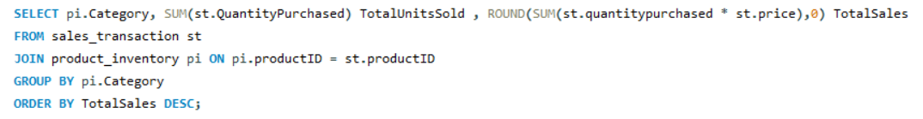
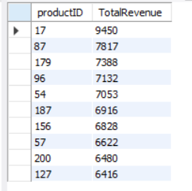
QUERY 8: Evaluate the performance of the product categories based on the total sales.

Slide 12
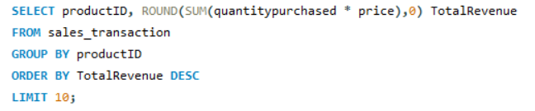
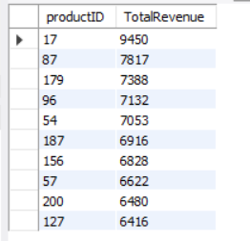
QUERY 9: Identify the top 10 products by total sales revenue

Slide 13
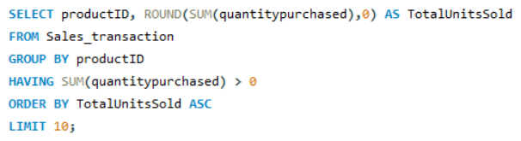
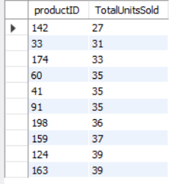
QUERY 10: Identify the 10 least-selling products.

Slide 14
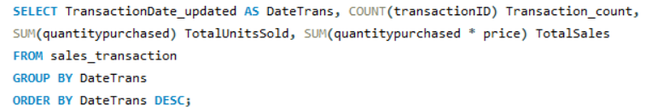
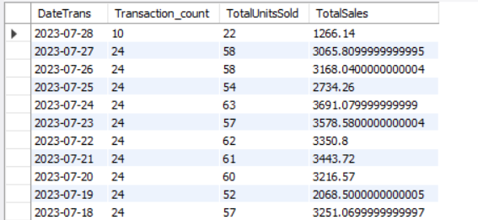
QUERY 11: Identify the sales trend from the sales_transaction table.

Slide 15
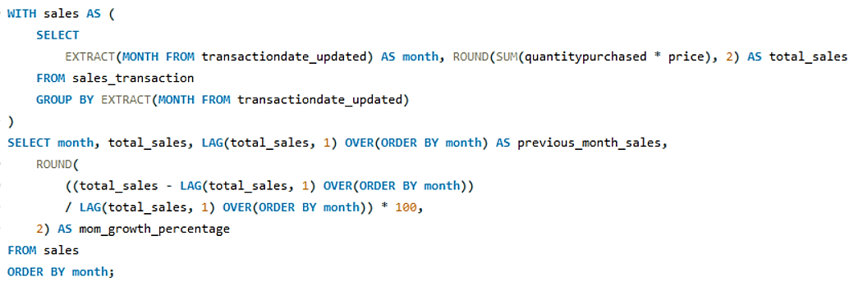
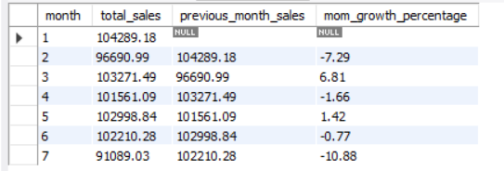
QUERY 12: Analyze the company's month-over-month sales growth rate.

Slide 16
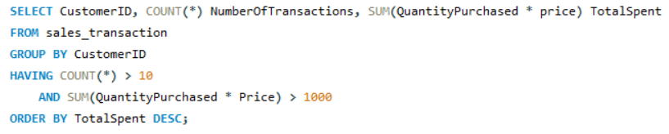
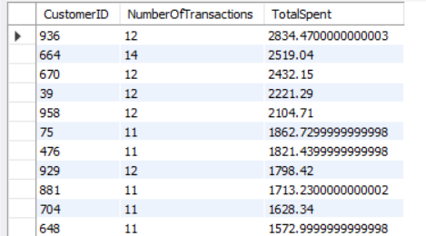
QUERY 13: Identify high-frequency customers by retrieving those with more than 10 transactions and a total spend exceeding 1000.

Slide 17
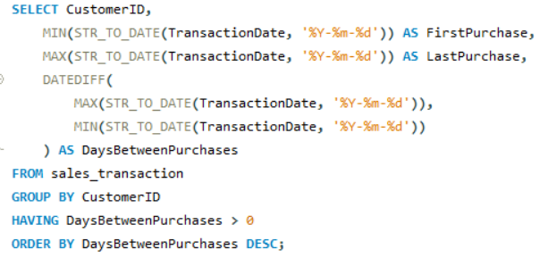
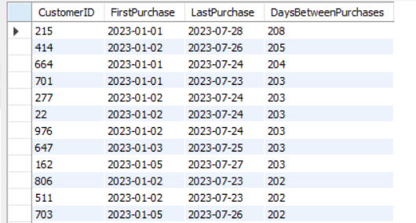
QUERY 14: Calculate the time difference between each customer's first and last purchase to analyze customer loyalty and longevity.

Slide 18
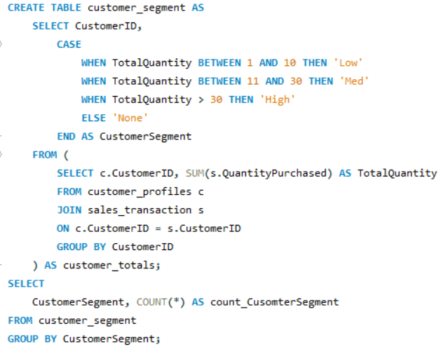
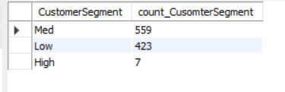
QUERY 15: Segment customers into purchasing tiers based on the total quantity of products bought and count the number of customers in each segment.

Slide 19
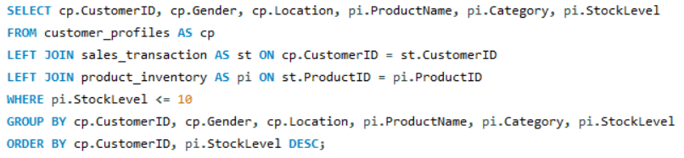
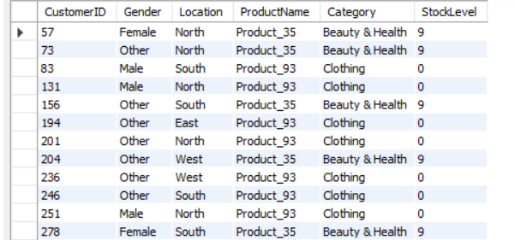
QUERY 16: To identify customers who have previously purchased products that are currently low in stock.

Slide 20
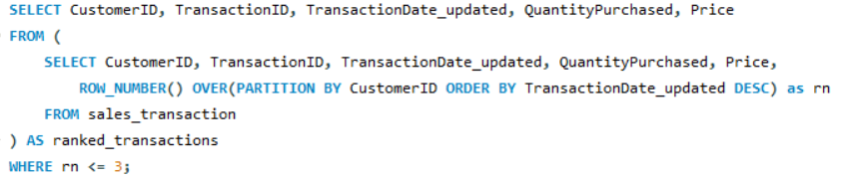
QUERY 17: Identify the top 3 most recent transactions for each customer.

Slide 21
THANK YOU
Contact:
Email: dristi1249@gmail.com
LinkedIn: https://www.linkedin.com/in/dristi-handique/

